Slide 1

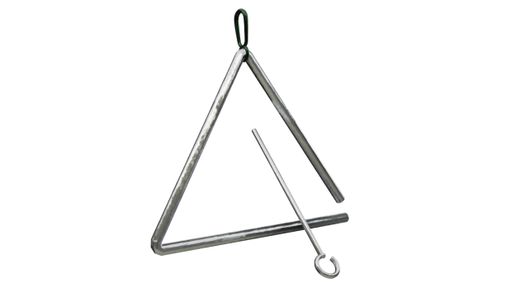
Music Inventory Project
By: AJ Albrecht, Hayley Huynh, Patrick McBrien

Slide 2
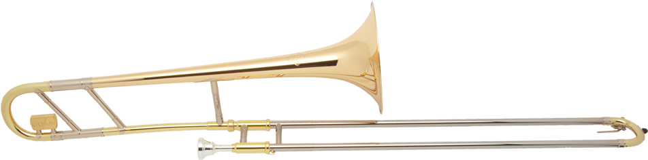
Our Project
The music store inventory allows for small business to manage their inventory.
The software creates relationships within the database with customers and instrument.
Presents traditional Microsoft Database information in a meaningful way.

Slide 3
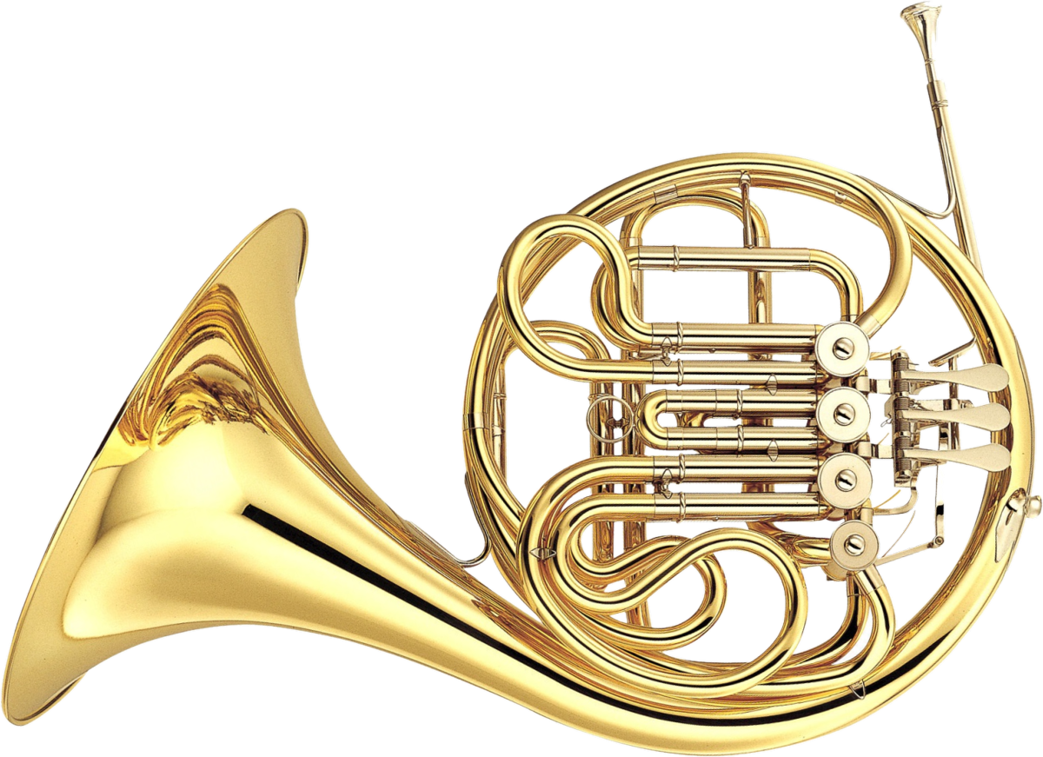
Original requirements
- Ability to add items
- Remove by sale or remove by declared lost, etc
- Set price, set sale price
- Searching functionality
- Store customer information

Slide 4
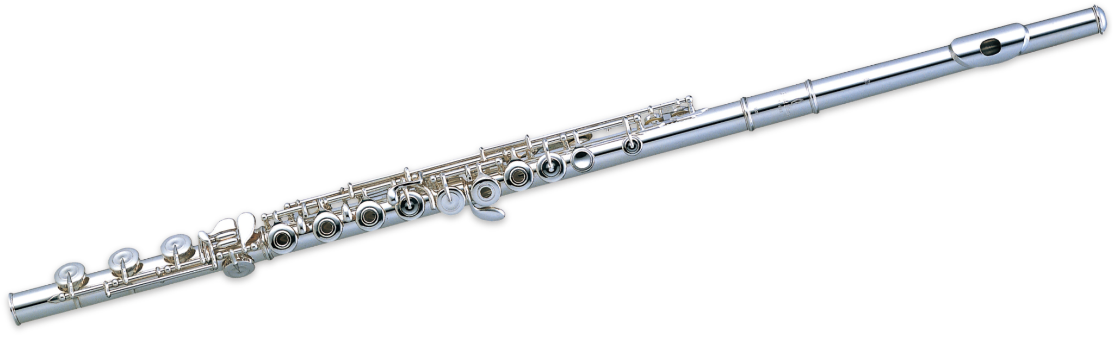
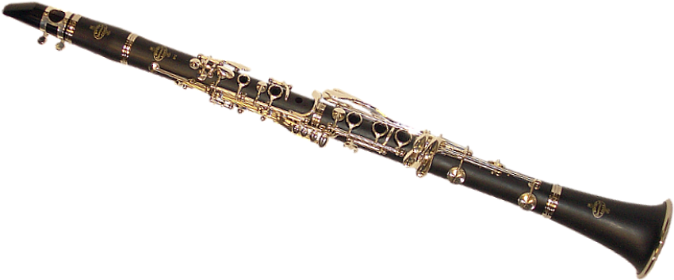
Team Roles
Patrick - Led development of the application and created most of the front end
Hayley - Worked on portion of the front end, back end and documentation
AJ - Worked on the back end, documentation and some research topics for the front end.

Slide 5
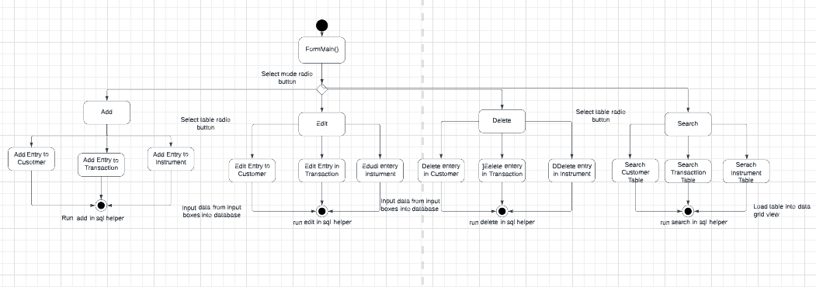
Diagrams - Activity Diagram

Slide 6
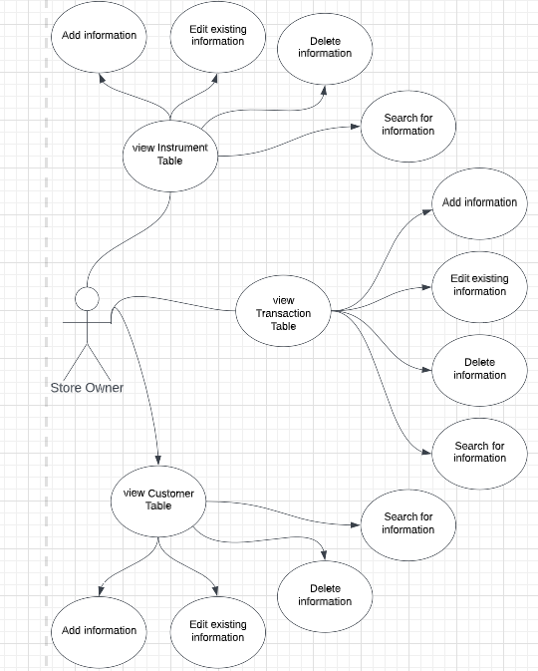
Diagrams - Use Case Diagram

Slide 7
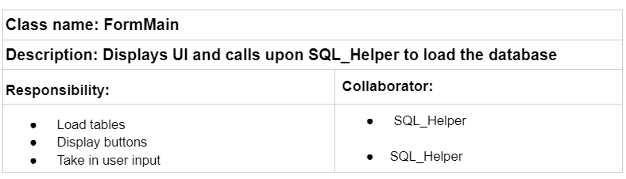
Diagrams - CRC Diagrams (Part 1)

Slide 8
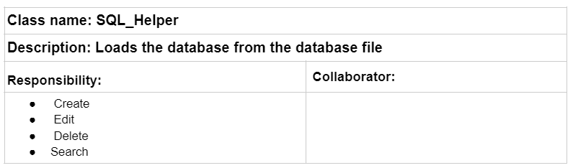
Diagrams - CRC Diagrams (Part 2)

Slide 9
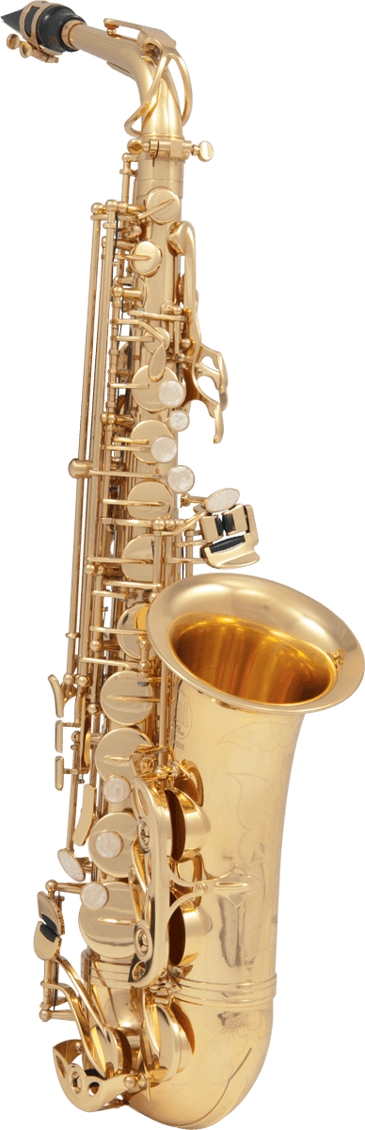
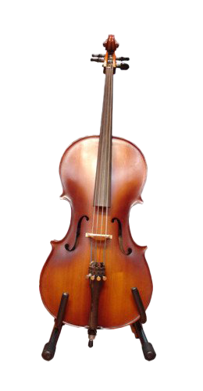
Demo
We will now demonstrate the application running.

